Slide 1
OnClick Section Zoom

Slide 2
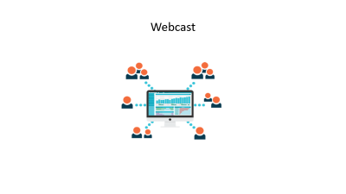
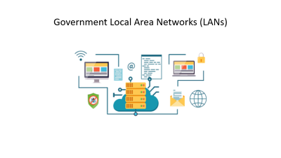
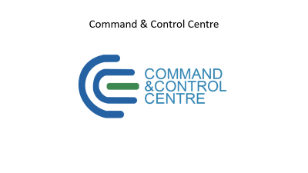
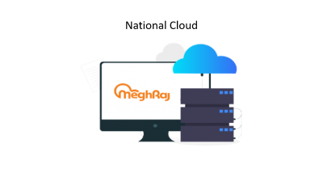
NIC Core Services

Slide 3
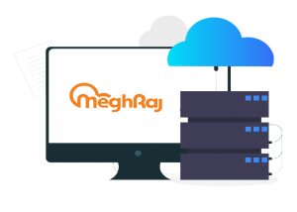
National Cloud

Slide 4
National Cloud
Meghraj – the Cloud Computing initiative of the Government of India, focuses to accelerate delivery of e-services in the country while optimizing ICT spending of the Government. It ensures optimum utilization of the infrastructure and speed up the development and deployment of eGov applications.
NIC Cloud Services offers variety of service models such as:
Platform as a Service – PaaS provides pre-installed web and database servers so that you can publish and run web application without worrying about server setup.
Infrastructure as a Service – IaaS provides you basic virtual compute infrastructure resources like CPU, Memory, Disk Storage attached to blank VMs with allowing you to install OS, using ISOs, from scratch and customization.

Slide 5
Software as a Services – This provides on demand software service. SaaS is a software delivery model where users are not responsible for supporting the application or any of the components. The server infrastructure, OS and software is being managed by cloud services.
Storage as a Service – This provides you on demand storage of various types including file storage and block storage etc. File and Block storage are methods to store data on NAS and SAN storage systems. Each storage volume can be treated as an independent disk drive and it can be controlled by external server operating system.
Load Balancer as a Service – Load balancing Service allows you to efficiently get incoming network traffic requests distributed across a group of back-end servers (e.g. server farm / server pool). This service is available on demand for critical application requiring high availability and easy workload manageability.
Resource Monitoring as a Service – This service helps you to monitor the cloud resources utilization and its availability with allowing you to analyse the utilization trends for critical server resources like CPU, Memory, Network I/O etc. This helps you for better capacity planning and provide a better end-user experience.

Slide 6
Vulnerability Assessment Service – This service helps you to assess your Servers and networks for identifying the security vulnerabilities i.e. threats and risks they pose. A vulnerability assessment process detects and classifies system weaknesses in Servers, networks and communications equipment and predicts the effectiveness of countermeasures.
Backup Service – Allows you to backup the data and application code lying inside the Cloud Servers based on various parameters like frequency, retention period etc.
Application Performance Management (APM) Service – Application Performance Management (APM) provides the monitoring and management of performance, availability and user experience of software applications. APM strives to detect and diagnose complex application performance problems to maintain an expected level of service.
Data Analytics (DA) as a Service – Data Analytics as a service (DA-SaaS) refers to the provision of analytics software and operations through web-delivered technologies. These types of solutions offer businesses an alternative to developing internal hardware setups just to perform business analytics.

Slide 7
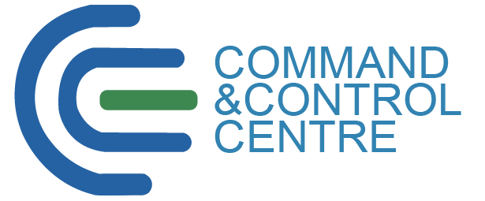
Command & Control Centre

Slide 8
Command & Control Centre
Command and Control Centre (CCC) aims to have a nation-wide view of the ICT infrastructure to effectively monitor the performances of all critical Government Services.
NIC has been offering services to the Government through its 4 National Data Centres and 30+ Mini Data Centres across the country.
The Command and Control Centre (CCC) was set up keeping in view the requirement of a centralized facility to seamlessly monitor the availability of all these Centres and Cloud Services. Over 10,000 e-Governance applications are being hosted by these Centres.
CCC is providing users with a customized dashboard of Network Management System (NMS) that enables it to monitor their respective applications. It also provides Application Performance Management (APM) through CCC to improve the availability, performance and functioning of critical applications.

Slide 9
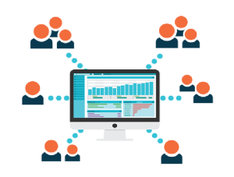
Webcast

Slide 10
Webcast
With the advent of high-end streaming media technology, the concept of doing live /on-demand webcast has gained popularity like never. Webcast allows to extend the reach of the event to all corners of the world, with no limitations of physical or geographical boundaries.
At National Informatics Centre, the events get an optimum webcast with flawless production quality. NIC’s webcast service offers various solution for an event, bringing onsite production, hosting, and streaming to millions of online viewers.
Live Webcast: the transmission of live or pre-recorded audio or video to personal computers that are connected to the Internet. Participants can use a chat window to type in questions to the presenter during the session. Web casts simulate the look and feel of a live event and can even be recorded for later viewing for those who missed the original web cast. This method is also less expensive than satellite broadcasting.

Slide 11
On-Demand Webcast: Pre-recorded clips are delivered, or streamed, to users upon request. A user who clicks a link to an on-demand clip watches the clip from the beginning. The user can fast-forward, rewind, or pause the clip. On demand streams can be created from archived live events or recorded clips.
Technology used at NIC:
Encoder : Flash Media Live Encoder (FMLE)
Server : NIC Media Streaming Server
Player : HLS Player
Protocols : HTTP / RTMP

Slide 12
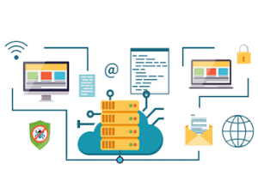
Government Local Area Networks (LANs)

Slide 13
Government Local Area Networks (LANs)
NIC provides computer support to all the Central Government Departments, State Government Departments and District Administration. NIC has set up a satellite-based computer communication network for providing Email, Internet, File Transfer, access to National & International databases, EDI, etc.
NIC has set up a Local Area Networks (LAN) in Central Government Departments and State Government Secretariats. Government LAN Service helps to connect various Government Departments located across States and Union Territories.
Over the years NIC has extended the satellite based Wide Area Network in all the Central Government offices and State Government Secretariats.
NIC has been training the Government Employees on a regular basis to enable them use computerized MIS and Databases; up to the district level.

